Slide 1
Apologetics… Defending the Faith
Scripture in Support of Our Catholic Beliefs
Lesson 5 – One Authoritative Church
Notes:
We’ve gone over the definition of apologetics and why we should all endeavor to be at least somewhat proficient at it. Then we covered the misunderstandings between the Protestant and Catholic versions lf the ten commandments, and finally the issues abut idolatry and the actual teachings of the Church and the practices of Catholics.

Slide 2
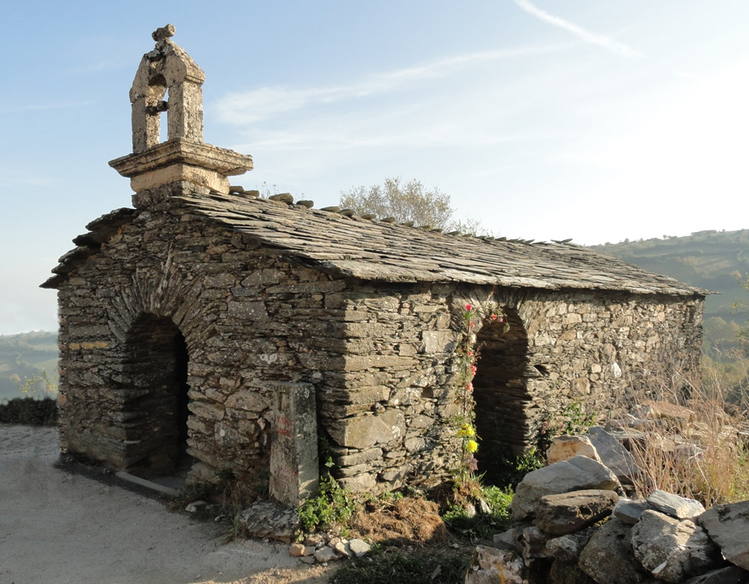
How Many Churches?
This is my Church!
Notes:
A Baptist minster was shipwrecked and stranded on a deserted island.
After many years a ship happened upon his island and he gave his rescuers a guided tour.
They came upon a beautifully made little stone chapel and he proudly proclaimed “That’s my Church!”

Slide 3
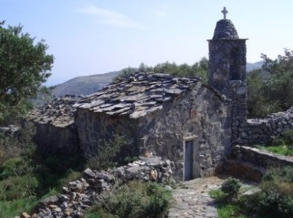
How Many Churches?
Notes:
A short distance away was another, smaller stone building that he failed to even mention.
His rescuers stopped and asked him, “What’s that little building over there?”
He looked over his shoulder and said casually, with some distain,

Slide 4
How Many Churches?
“Oh, That’s my OLD Church.”
Notes:
“oh, That’s my Old church

Slide 5
Apologetics Review
Paul teaches us…
“…but sanctify Christ as Lord in your hearts. Always be ready to give an explanation to anyone who asks you for a reason for your hope,”
1 Peter 3:15
Notes:
This morning I will be putting forth some possibly negative information about Protestantism.
I do this with you as Catholics not to demean Protestants but to educate you on some points that you should know, but keep filed away in the back of your minds.

Slide 6
Apologetics Review
…but do it with gentleness and reverence, keeping your conscience clear, so that, when you are maligned, those who defame your good conduct in Christ may themselves be put to shame.
1 Peter 3:16
Notes:
But remember, NEVER confront a Protestant with the things that we believe are wrong with their beliefs. Always approach a discussion of differing faith with reverence and respect for the other person.

Slide 7
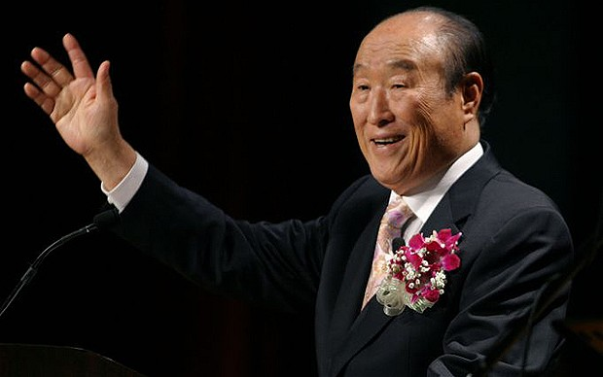
How Many Churches?
In 1954, the Reverend Sun Myung Moon founded the Unification Church in South Korea, as the sole authority on matters of faith and morals, in order to unify all of mankind to one faith in the world. Moon gathered many disciples and his congregation grew steadily under his leadership.
Notes:
In 1954, the Reverend Sun Myung Moon founded the Unification Church in South Korea, as the sole authority on matters of faith and morals, in order to unify all of mankind to one faith in the world. Moon gathered many disciples and his congregation grew steadily under his leadership.

Slide 8
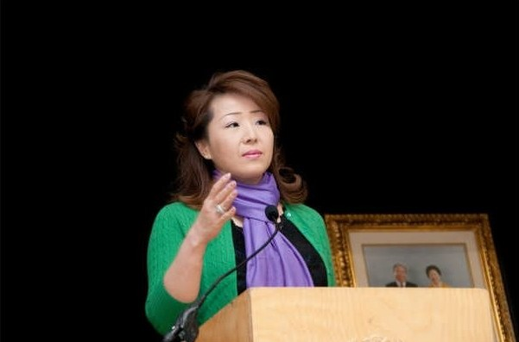
How Many Churches?
As he grew older and it was difficult for him to continue with the same vigor he turned leadership of the church over to his daughter In Jin Moon who radically changed the teachings and doctrines of the church and greatly reduced its membership to a current skeleton of its former self.
61 years
Notes:
As he grew older and it was difficult for him to continue with the same vigor he turned leadership of the church over to his daughter In Jin Moon who radically changed the teachings and doctrines of the church and greatly reduced its membership to a current skeleton of its former self.
The Unification Church is 61 Years Old

Slide 9
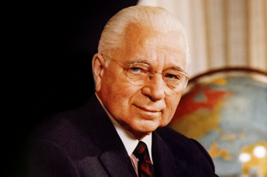
How Many Churches?
In 1933, Herbert W. Armstrong founded the Radio Church of God in Oregon, renaming it the Worldwide Church of God in 1968. He preached a combination of New Covenant and Old Covenant laws and espoused strict adherence to Sabbath traditions
and dietary law. Upon his death in
1986, the church continued under
the leadership of a council of
elders but has diminished in
popularity ever since.
82 Years
Notes:
In 1933, Herbert W. Armstrong founded the Radio Church of God in Oregon, renaming it the Worldwide Church of God in 1968. He preached a combination of New Covenant and Old Covenant laws and espoused strict adherence to Sabbath traditions and dietary law. Upon his death in 1986, the church continued under the leadership of a council of elders but has diminished in popularity ever since.
the Worldwide Church of God is 82 years old

Slide 10
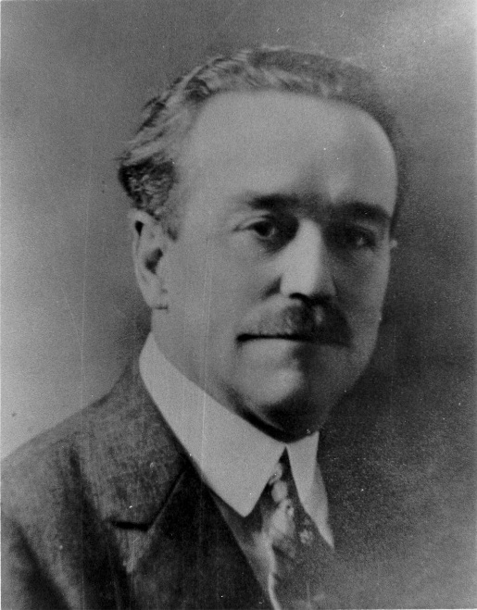
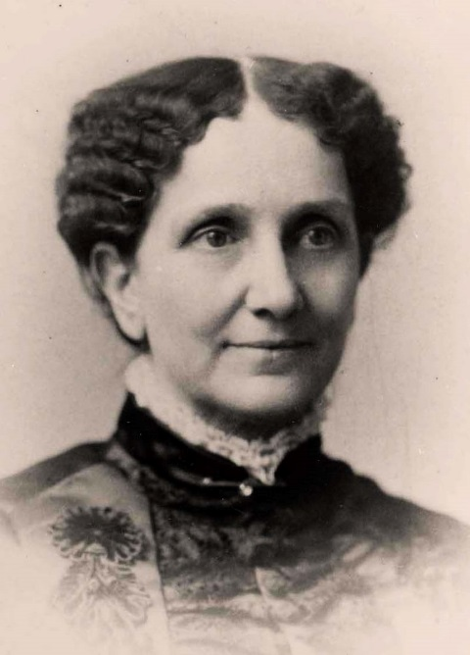
How Many Churches?
In 1900
Charles Parham founded
the Pentecostal Church
115 Years
In 1879
Mary Baker Eddy founded
Christian Science
136 Years
Notes:
In 1900, Charles Parham founded the Pentecostal Church in Southern California.
It is 115 Years Old
In 1879 Mary Baker Eddy founded Christian Science.
It is 136 years old

Slide 11
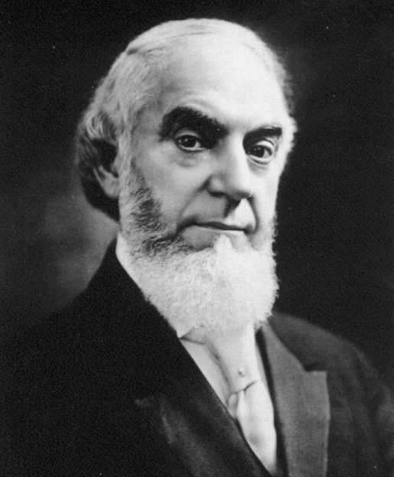
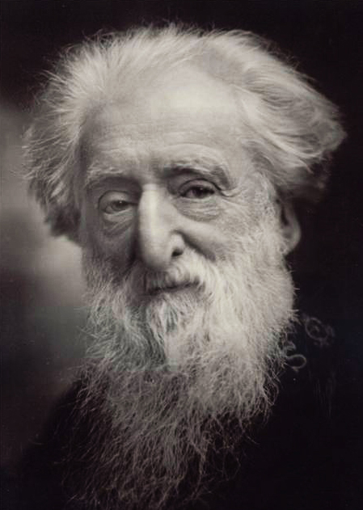
How Many Churches?
In 1870
Charles Russell founded the
Jehovah’s witnesses
145 Years
In 1865
William Booth founded the Salvation Army
150 years
Notes:
In the year 1870 Charles Russell founded Jehovah’s witnesses
145 years old
In the year 1865 William Booth founded the Salvation Army
150 years old

Slide 12
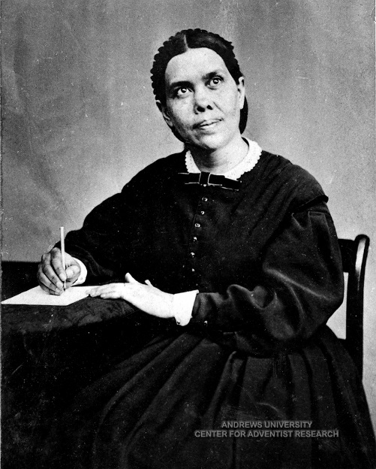
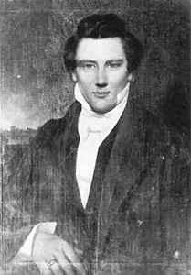
How Many Churches?
In 1860
Ellen White founded the Seventh Day Adventists
155 Years
In 1830
Joseph Smith founded the
Church of Latter-day Saints. (Mormon)
185 Years
Notes:
In the year 1860 Ellen White founded the Seventh Day Adventists
155 years old
In the year 1830 Joseph Smith founded the Church of Latter-day Saints. He was twenty four when he published the Book of Mormon
It is 185 years old

Slide 13
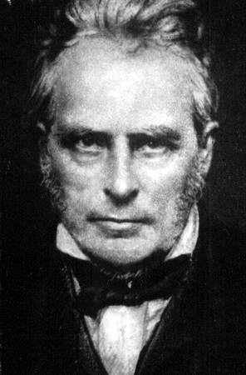
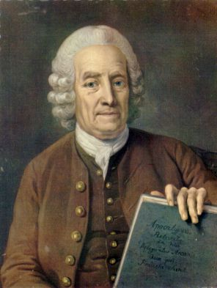
How Many Churches?
In 1828
John Darby Founded the Exclusive Brethren Church
187 Years
In 1747
Emanuel Swedenborg Founded
The New Church
268 Years
Notes:
In the year 1828 John Darby Founded the Exclusive Brethren Church
187 years old
In the year 1747 Emanuel Swedenborg Founded The New Church (or Swedenborgianism)
268 years old

Slide 14
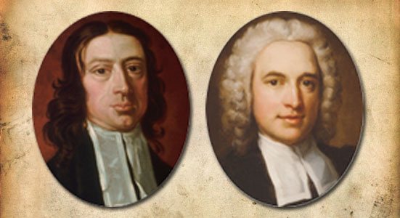
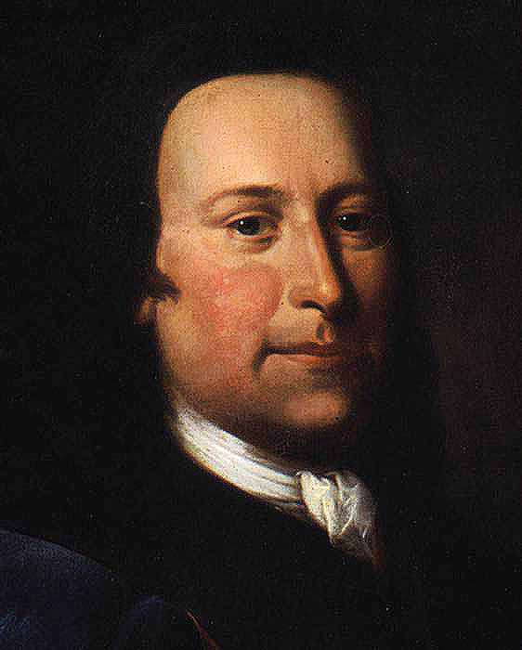
How Many Churches?
In 1739
John & Charles Wesley Founded
The Methodist Church
276 Years
In 1727
Count Zinendorf Founded
The Moravians
288 Years
Notes:
In the year 1739 John Wesley Founded the Methodist Church
276 years old
In the year 1727 Count Zinendorf Founded Moravians
288 years old

Slide 15
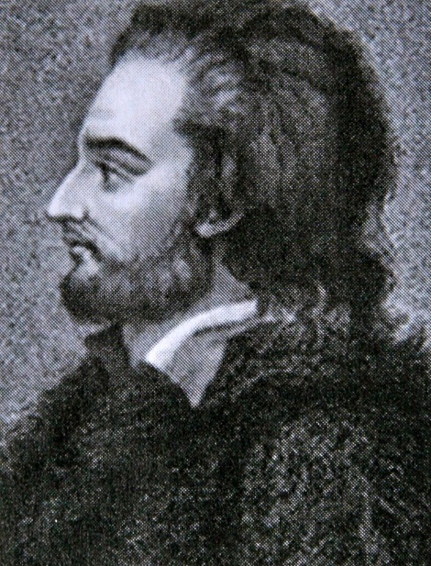
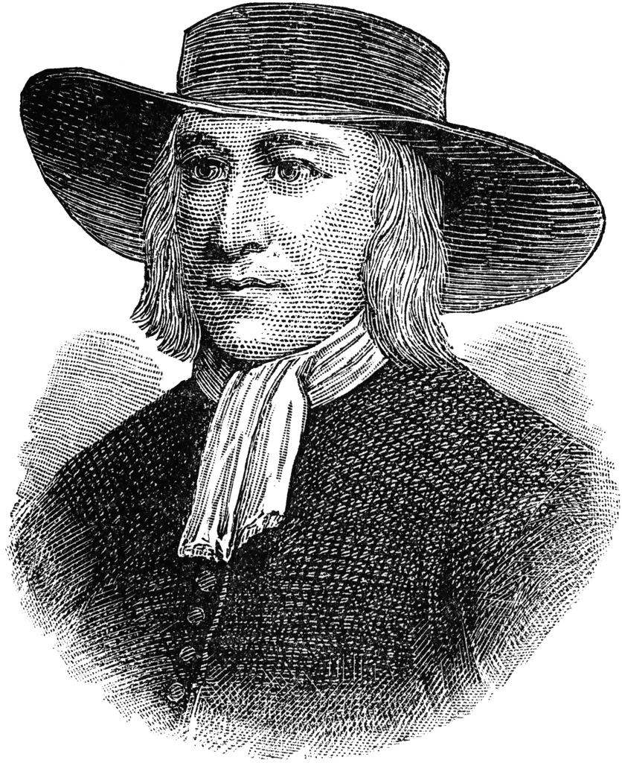
How Many Churches?
In 1693
Jakob Ammann Founded
the Amish Church
322 Years
In 1647
George Fox Founded
the Quakers
368 Years
Notes:
In the year 1693 Jakob Ammann Founded the Amish Church
322 years old
In the year 1647 George Fox Founded the Quakers
368 years old

Slide 16
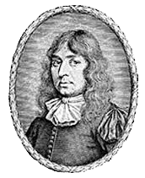
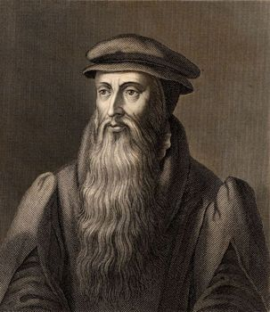
How Many Churches?
1605
John Smyth Founded
the Baptist Church
410 Years
In 1560
John Knox Founded
the Presbyterian Church
455 Years
Notes:
In the year 1605 John Smyth Founded the Baptist Churches
410 years old
In the year 1560 John Knox Founded the Presbyterian Church
455 years old

Slide 17
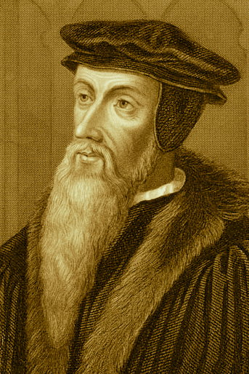
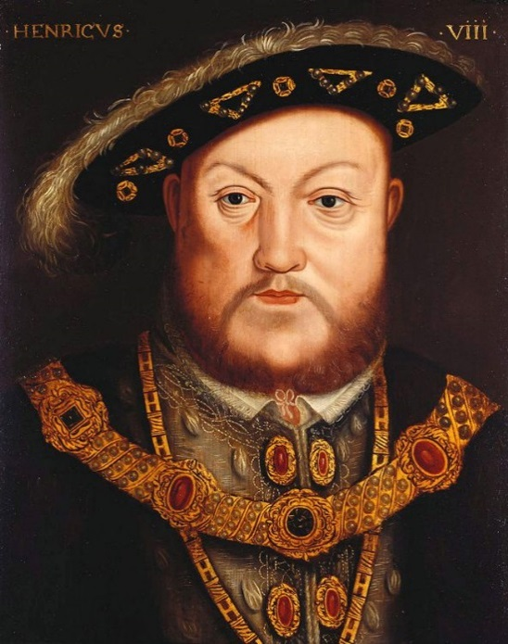
How Many Churches?
1536
John Calvin Founded
Calvinism
479 Years
1534
King Henry VIII Founded
the Anglican Church
481 Years
Notes:
In the year 1536 John Calvin Founded Calvinism
479 years old
In the year 1534 King Henry 8 Founded the Anglican Communion
481 years old

Slide 18
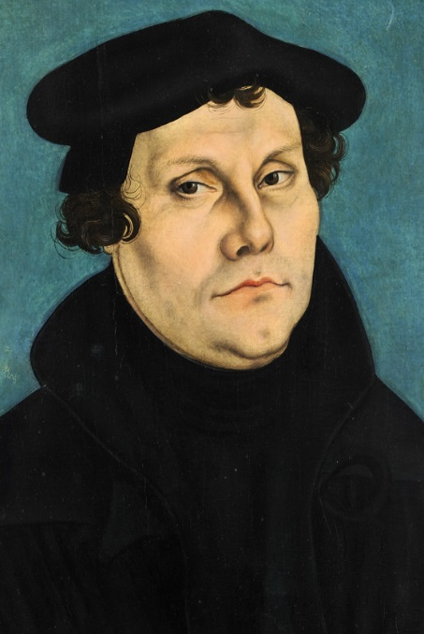
How Many Churches?
In 1517
Martin Luther Founded the Lutheran Church
498 Years
Notes:
In the year 1517 Martin Luther Founded the Lutheran Church
498 years ago.

Slide 19
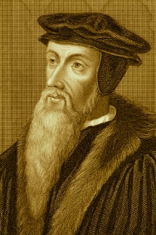
How Many Churches?
All these are Churches of Man
Notes:
These men and women all have one thing in common. They all believe that their own beliefs, their own interpretation of Christianity, their own list of rules is the one and only truth.
Some believed it sincerely and truly knew in their hearts that they were right, and all others before them had it wrong. Some, like Henry the eighth for selfish, sinful reasons created a church to suit his own desires.
But all, felt that they alone should be the leader of TRUE Christianity.
At last count, there are over 35,000 denominations of Protestantism. Each claim to have their own version of “The Truth”

Slide 20
A Side Note
Protestant (n., adj.)
from German or French protestant, from Latin protestantem (nominative protestans), present participle of protestari (see protest (n.))
Denomination (n.)
"a naming, act of giving a name to," from Old French denominacion "nominating, naming," from Latin denominationem (nominative denominatio) "a calling by anything other than the proper name” to de-nominate, or remove from.
Notes:
Protestant (n., adj.)
from German or French protestant, from Latin protestantem (nominative protestans), present participle of protestari (see protest (n.))
Denomination (n.)
"a naming, act of giving a name to," from Old French denominacion "nominating, naming," from Latin denominationem (nominative denominatio) "a calling by anything other than the proper name” to de-nominate, or remove from.

Slide 21
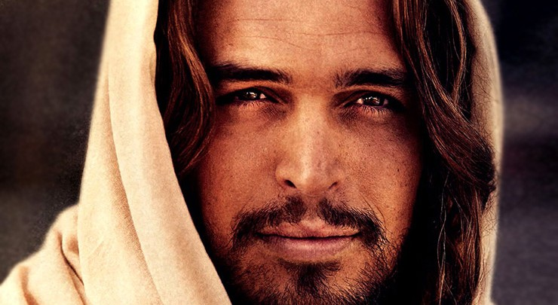
One Church
Around 30 AD, Jesus Christ Founded Christianity
1,985 Years Ago
Notes:
In 30-33 AD Jesus Christ Founded His ONE Church.
1,985 years ago.
1,487 years before Martin Luther decided that the Pope and all of the Bishops were wrong about Christianity, and that only he was right…

Slide 22
One Church
I am the way, the truth and the life
One Church
Notes:
His ONE True Church

Slide 23
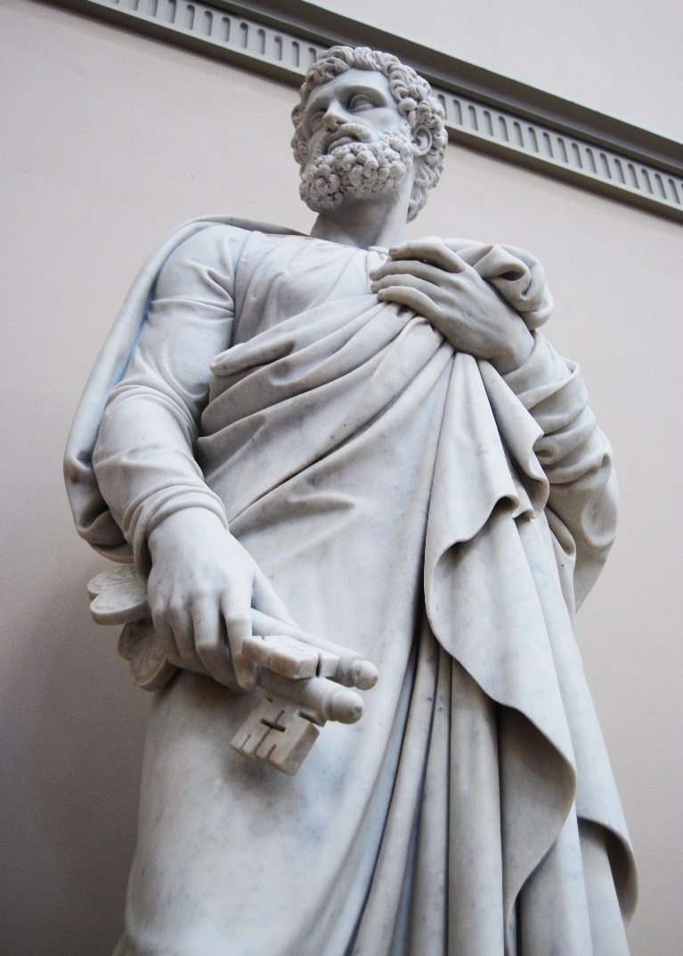
The Keys To The Kingdom
¹⁸ And so I say to you, you are Peter, and upon this rock I will build my church, and the gates of the netherworld shall not prevail against it. ¹⁹ I will give you the keys to the kingdom of heaven. Whatever you bind on earth shall be bound in heaven; and whatever you loose on earth shall be loosed in heaven.”
Matthew 16:18-19
Notes:
¹⁵ He said to them, “But who do you say that I am?” ¹⁶ Simon Peter said in reply, “You are the Messiah, the Son of the living God.” ¹⁷ Jesus said to him in reply, “Blessed are you, Simon son of Jonah. For flesh and blood has not revealed this to you, but my heavenly Father.
¹⁸ And so I say to you, you are Peter, and upon this rock I will build my church, (Singular) and the gates of the netherworld shall not prevail against it. ¹⁹ I will give you the keys to the kingdom of heaven. Whatever you bind on earth shall be bound in heaven; and whatever you loose on earth shall be loosed in heaven.”

Slide 24
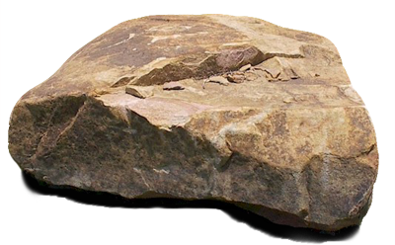
The Keys To The Kingdom
A Protestant argument: Big Rock, vs Little Rock
Petros: masculine
a shifting, rolling, or insecure stone
Petra: feminine
a solid, immov­able rock.
Notes:
The Protestant argument: Big Rock, vs Little Rock
Petra, feminine, is a solid, massive unmovable rock while Petrus, masculine, is a shifting, rolling or insecure stone.
Therefore, Peter and the church could not be the same, therefore Peter could not be the head of the church.

Slide 25
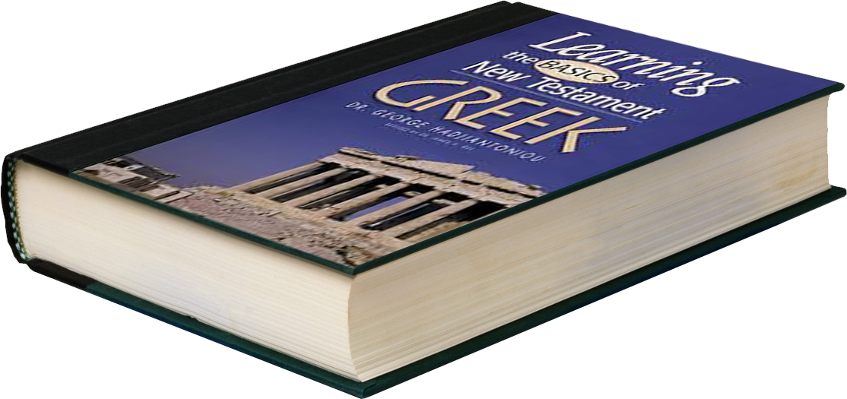
The Keys To The Kingdom
A little Greek 101
¹⁸ And so I say to you, you are Petros (Masculine), and upon this Petra (feminine) I will build my church, and the gates of the netherworld shall not prevail against it.
What did Jesus really say?
Notes:
If you are writing in Greek, the words you heard from another person, either directly or indirectly, and you were concerned with the correct Greek grammar, you must use the masculine form when speaking of a man. The Feminine, which better suites the church also describes an immovable object.
If you read the passage, Jesus says YOU are petros and upon THIS petra I will build my church. But did he actually say that?

Slide 26
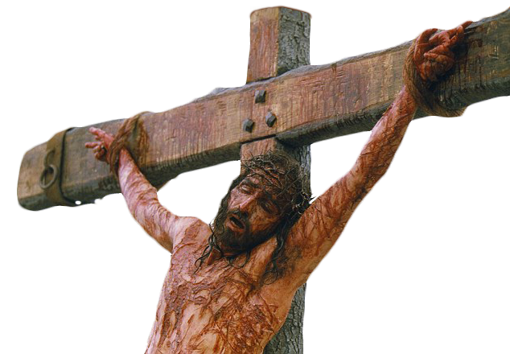
One Church
At his crucifixion:
⁴⁶ And about three o’clock Jesus cried out in a loud voice, “Eli, Eli, lema sabachthani?” which means, “My God, my God, why have you forsaken me?”
Matthew 27:46
“Eli, Eli,
lema sabachthani?”
The language is Farsi, so we know from scripture that Jesus spoke Farsi
Notes:
But we know from scripture that Jesus spoke Farsi as the common language of the time and region.

Slide 27
One Church
The word for Rock in Farsi? Kefa
Kefa
a shifting, rolling, or insecure stone
Kefa
a solid, immov­able rock.
Notes:
The word for rock in Farsi is Kefa
Speaking in Farsi, the only thing Jesus could have said in grammatically correct Farsi is “You are Kefa and upon this Kefa I will build my Church.

Slide 28
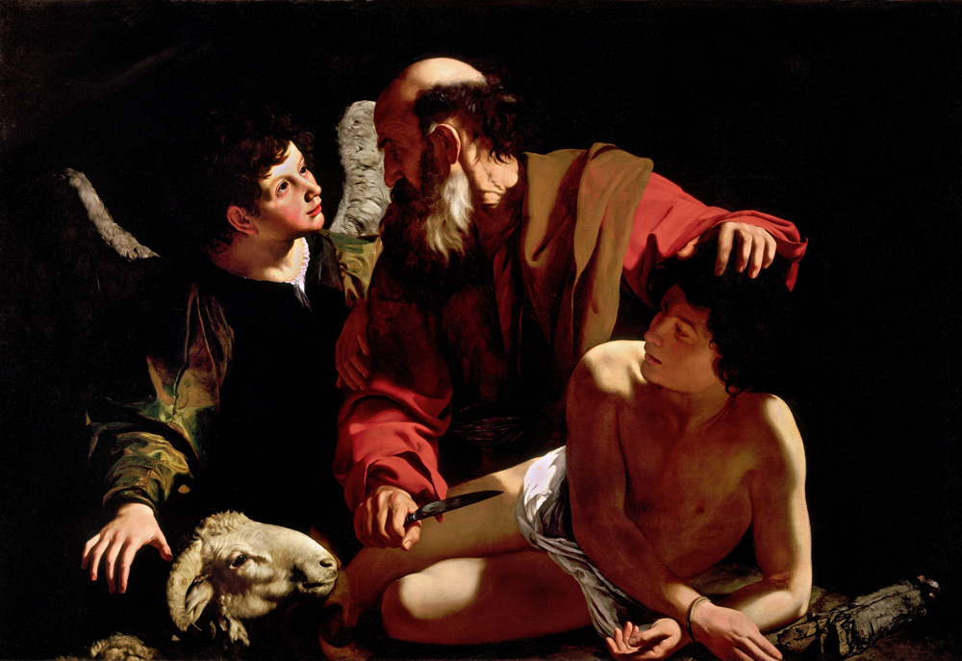
One Church
⁵ No longer will you be called Abram; your name will be Abraham, for I have made you a father of many nations.
Genesis 17:5
Notes:
The renaming of important figures in the Bible is a clear indication of having received a new mission in life by God.
⁵ No longer will you be called Abram; your name will be Abraham, for I have made you a father of many nations.
Genesis 17:5
Abram demonstrated his great faith in the Lord by his willingness to sacrifice his son to the will of God. For his great faith, God renamed him Abraham and made a covenant that he would be the father of a great nation, of many nations.

Slide 29
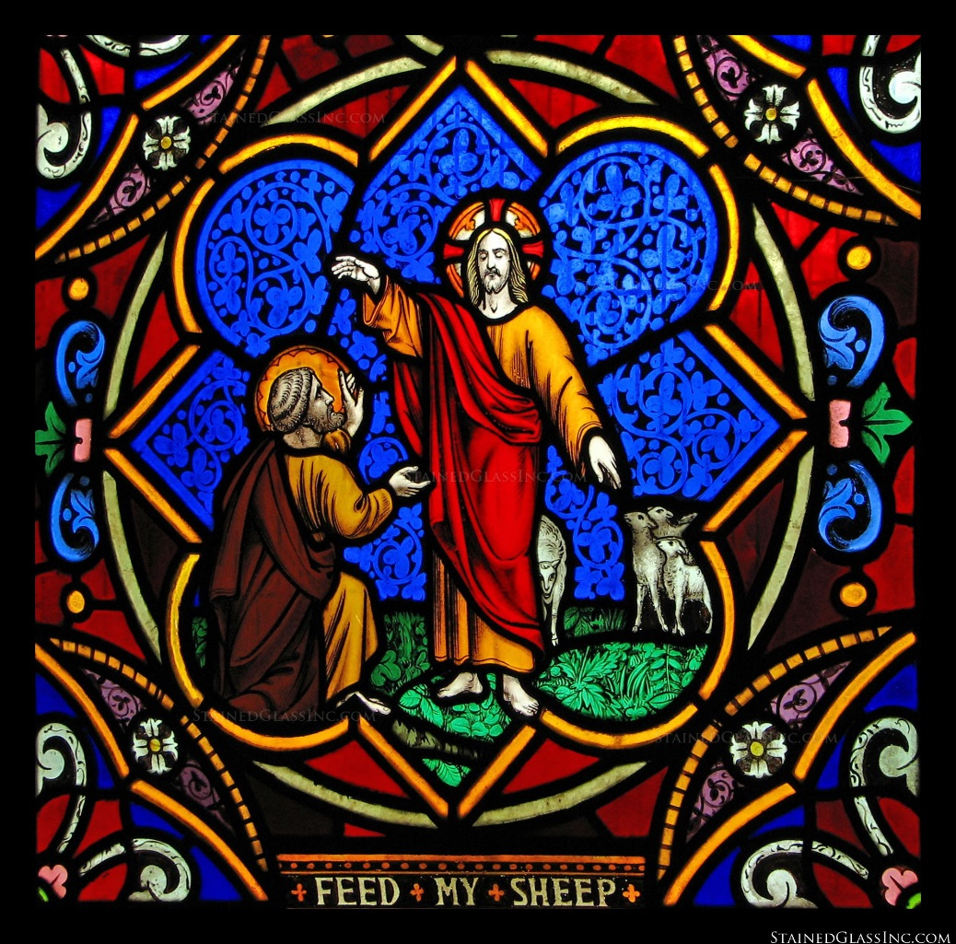
One Church
¹⁷ Jesus said to him in reply, “Blessed are you, Simon son of Jonah. For flesh and blood has not revealed this to you, but my heavenly Father. ¹⁸ And so I say to you, you are Peter, and upon this rock I will build my church, and the gates of the netherworld shall not prevail against it.
Matthew 16:17-18
Notes:
¹⁷ Jesus said to him in reply, “Blessed are you, Simon son of Jonah. For flesh and blood has not revealed this to you, but my heavenly Father. ¹⁸ And so I say to you, you are Peter, and upon this rock I will build my church, and the gates of the netherworld shall not prevail against it.
Matthew 16:17-18
In renaming Simon to Peter, Christ clearly indicated a preferential station for Peter, elevating his importance in the Church.

Slide 30
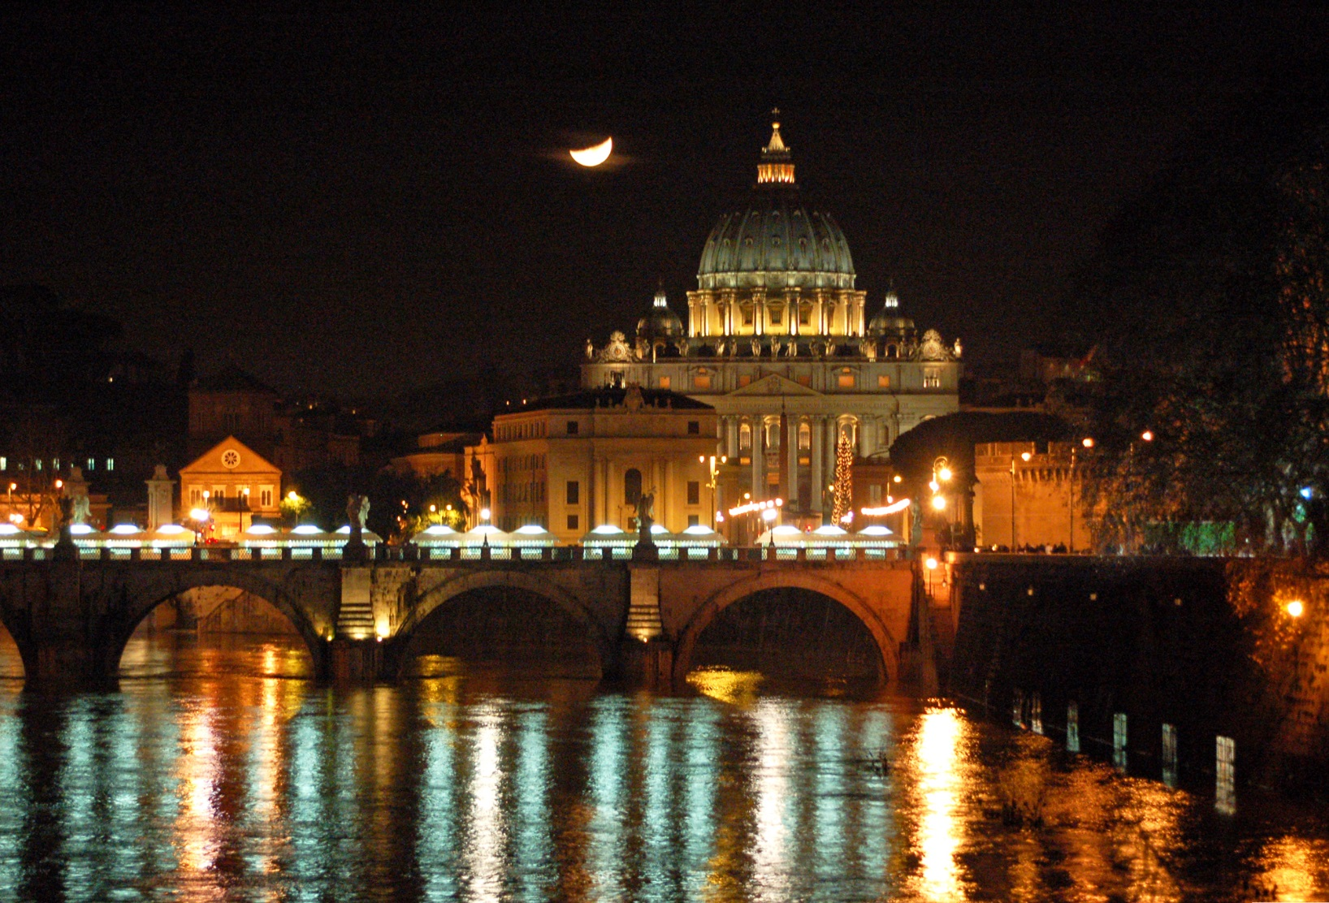
One Church
Peter is the rock upon which Christ built His ONE Church
Notes:
Jesus spoke Farsi. The word for rock in Farsi is Kefa
Viewed this way, Peter is the rock upon which Christ built His One Church

Slide 31
One Church
According to scripture…
Notes:
What does the Bible have to say about one or many churches?

Slide 32
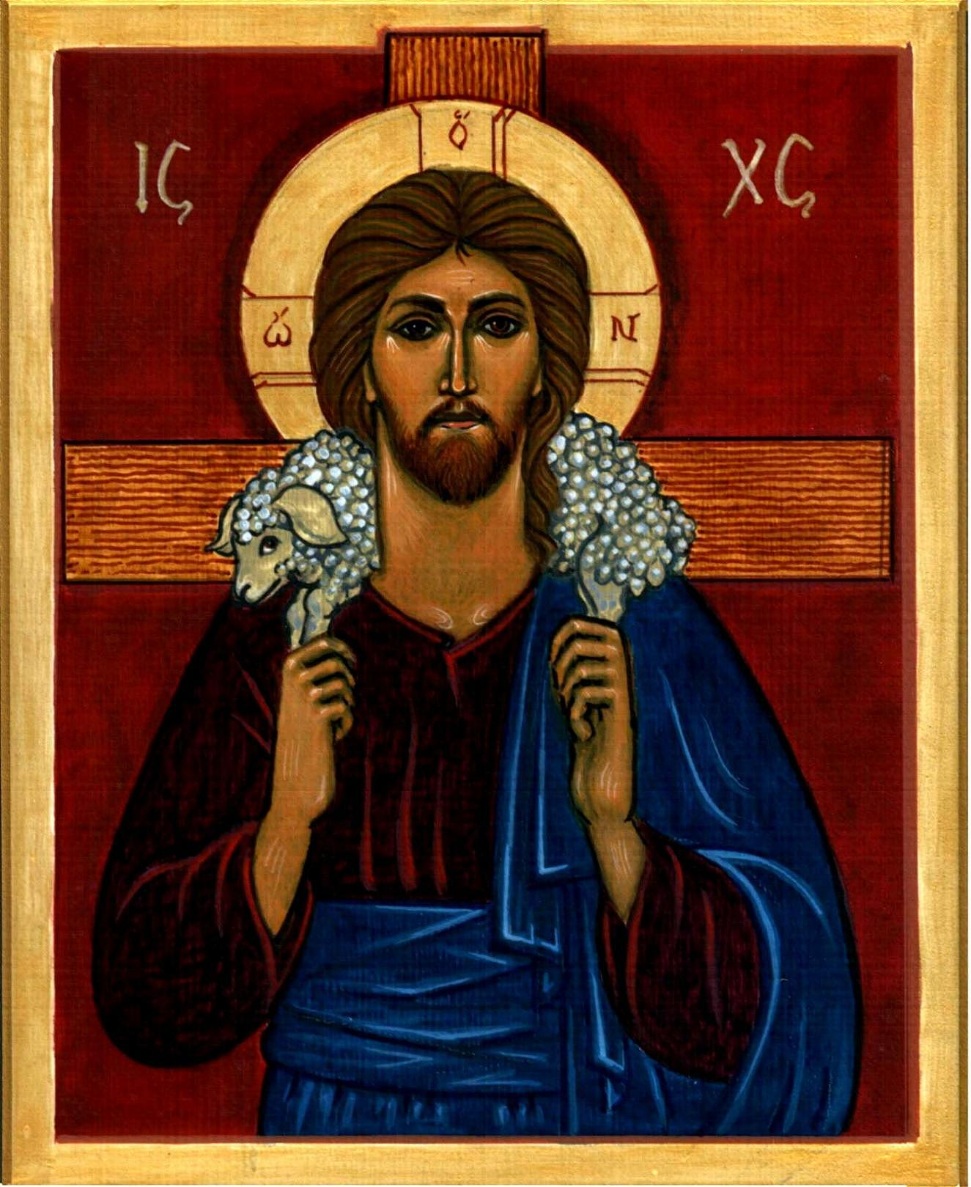
One Church
John 10:16 ¹⁶ I have other sheep that do not belong to this fold. These also I must lead, and they will hear my voice, and there will be one flock, one shepherd.
Notes:
John 10:16 ¹⁶ I have other sheep that do not belong to this fold. These also I must lead, and they will hear my voice, and there will be one flock, one shepherd.
Jesus teaching the disciples.

Slide 33
One Church
John 17:17-23 ¹⁷ Consecrate them in the truth. Your word is truth. ¹⁸ As you sent me into the world, so I sent them into the world. ¹⁹ And I consecrate myself for them, so that they also may be consecrated in truth. ²⁰ I pray not only for them, but also for those who will believe in me through their word, ²¹ so that they may all be one, as you, Father, are in me and I in you, that they also may be in us, that the world may believe that you sent me. ²² And I have given them the glory you gave me, so that they may be one, as we are one, ²³ I in them and you in me, that they may be brought to perfection as one, that the world may know that you sent me, and that you loved them even as you loved me.
Notes:
John 17:17-23 Jesus prays to the Father before His betrayal ¹⁷ Consecrate them in the truth. Your word is truth. ¹⁸ As you sent me into the world, so I sent them into the world. ¹⁹ And I consecrate myself for them, so that they also may be consecrated in truth. ²⁰ I pray not only for them, but also for those who will believe in me through their word, ²¹ so that they may all be one, as you, Father, are in me and I in you, that they also may be in us, that the world may believe that you sent me. ²² And I have given them the glory you gave me, so that they may be one, as we are one, ²³ I in them and you in me, that they may be brought to perfection as one, that the world may know that you sent me, and that you loved them even as you loved me.

Slide 34
One Church
Romans 15:5-6 ⁵ May the God of endurance and encouragement grant you to think in harmony with one another, in keeping with Christ Jesus, ⁶ that with one accord you may with one voice glorify the God and Father of our Lord Jesus Christ.
Notes:
Romans 15:5-6 ⁵ May the God of endurance and encouragement grant you to think in harmony with one another, in keeping with Christ Jesus, ⁶ that with one accord you may with one voice glorify the God and Father of our Lord Jesus Christ.

Slide 35
One Church
1 Corinthians 1:10 ¹⁰ I urge you, brothers, in the name of our Lord Jesus Christ, that all of you agree in what you say, and that there be no divisions among you, but that you be united in the same mind and in the same purpose.
Notes:
1 Corinthians 1:10 ¹⁰ I urge you, brothers, in the name of our Lord Jesus Christ, that all of you agree in what you say, and that there be no divisions among you, but that you be united in the same mind and in the same purpose.

Slide 36
One Church
1 Corinthians 12:13 ¹³ For in one Spirit we were all baptized into one body, whether Jews or Greeks, slaves or free persons, and we were all given to drink of one Spirit.
Notes:
1 Corinthians 12:13 ¹³ For in one Spirit we were all baptized into one body, whether Jews or Greeks, slaves or free persons, and we were all given to drink of one Spirit.

Slide 37
One Church
Ephesians 4:3-6 ³ striving to preserve the unity of the spirit through the bond of peace: ⁴ one body and one Spirit, as you were also called to the one hope of your call; ⁵ one Lord, one faith, one baptism; ⁶ one God and Father of all, who is over all and through all and in all.
Notes:
Ephesians 4:3-6 ³ striving to preserve the unity of the spirit through the bond of peace: ⁴ one body and one Spirit, as you were also called to the one hope of your call; ⁵ one Lord, one faith, one baptism; ⁶ one God and Father of all, who is over all and through all and in all.

Slide 38
One Church
Colossians 3:15 ¹⁵ And let the peace of Christ control your hearts, the peace into which you were also called in one body. And be thankful
Notes:
Colossians 3:15 ¹⁵ And let the peace of Christ control your hearts, the peace into which you were also called in one body. And be thankful

Slide 39
One Church
Clearly, Christ wanted one Unified Church for all, which He
Himself founded, and entrusted to Peter and the Apostles
Notes:
Clearly, Christ wanted one Unified Church for all Which He Himself founded, and entrusted to Peter and the Apostles

Slide 40
How Many Churches?
All other Christian Churches are churches of men
who Interpreted Christ’s teachings their own way.
Notes:
35,000 separate denominations?
Protestants?

Slide 41
Many Churches
According to scripture…
Notes:
What does the Bible have to say about divisions in the Church?

Slide 42
One Church
Romans 16:17 ¹⁷ I urge you, brothers, to watch out for those who create dissensions and obstacles, in opposition to the teaching that you learned; avoid them.
Notes:
Paul even issues a warning about those who would divide the Church.
Romans 16:17 ¹⁷ I urge you, brothers, to watch out for those who create dissensions and obstacles, in opposition to the teaching that you learned; avoid them.

Slide 43
One Church
2 Peter 3:16:17 ¹⁶ speaking of these things as he does in all his letters. In them there are some things hard to understand that the ignorant and unstable distort to their own destruction, just as they do the other scriptures. ¹⁷ Therefore, beloved, since you are forewarned, be on your guard not to be led into the error of the unprincipled and to fall from your own stability.
Notes:
2 Peter 3:16:17 ¹⁶ speaking of these things as he does in all his letters. In them there are some things hard to understand that the ignorant and unstable distort to their own destruction, just as they do the other scriptures. ¹⁷ Therefore, beloved, since you are forewarned, be on your guard not to be led into the error of the unprincipled and to fall from your own stability.

Slide 44
One Church
2 Peter 1:20 ²⁰ Know this first of all, that there is no prophecy of scripture that is a matter of personal interpretation
Notes:
2 Peter 1:20 ²⁰ Know this first of all, that there is no prophecy of scripture that is a matter of personal interpretation

Slide 45
One Church
Luke 24:44-45 ⁴⁴ He said to them, “These are my words that I spoke to you while I was still with you, that everything written about me in the Law of Moses and in the prophets and psalms must be fulfilled.” ⁴⁵ Then he opened their minds to understand the scriptures.
Notes:
Given power to interpret the scriptures and to teach
Luke 24:44-45 ⁴⁴ He said to them, “These are my words that I spoke to you while I was still with you, that everything written about me in the Law of Moses and in the prophets and psalms must be fulfilled.” ⁴⁵ Then he opened their minds to understand the scriptures.

Slide 46
One Church
Acts 8:27-31 ²⁷ …Now there was an Ethiopian eunuch, a court official of the Candace, that is, the queen of the Ethiopians, in charge of her entire treasury, who had come to Jerusalem to worship, ²⁸ and was returning home. Seated in his chariot, he was reading the prophet Isaiah. ²⁹ The Spirit said to Philip, “Go and join up with that chariot.” ³⁰ Philip ran up and heard him reading Isaiah the prophet and said, “Do you understand what you are reading?” ³¹ He replied, “How can I, unless someone instructs me?” So he invited Philip to get in and sit with him.
Notes:
Acts 8:27-31 ²⁷ …Now there was an Ethiopian eunuch, a court official of the Candace, that is, the queen of the Ethiopians, in charge of her entire treasury, who had come to Jerusalem to worship, ²⁸ and was returning home. Seated in his chariot, he was reading the prophet Isaiah. ²⁹ The Spirit said to Philip, “Go and join up with that chariot.” ³⁰ Philip ran up and heard him reading Isaiah the prophet and said, “Do you understand what you are reading?” ³¹ He replied, “How can I, unless someone instructs me?” So he invited Philip to get in and sit with him.

Slide 47
One Church
1 Timothy 3:15 ¹⁵ But if I should be delayed, you should know how to behave in the household of God, which is the Church of the living God, the pillar and foundation of the truth.
Notes:
Where do we find the truth?
1 Timothy 3:15 ¹⁵ But if I should be delayed, you should know how to behave in the household of God, which is the Church of the living God, the pillar and foundation of the truth.

Slide 48
Authoritative Church
Old Testament Precedent
Isaiah 22:20-22
²⁰ On that day I will summon my servant Eliakim, son of Hilkiah; ²¹ I will clothe him with your robe, gird him with your sash, confer on him your authority. He shall be a father to the inhabitants of Jerusalem, and to the house of Judah. ²² I will place the key of the House of David on his shoulder; what he opens, no one will shut, what he shuts, no one will open.
Notes:
Old Testament Precedent
Isaiah 22:20-22
²⁰ On that day I will summon my servant Eliakim, son of Hilkiah; ²¹ I will clothe him with your robe, gird him with your sash, confer on him your authority. He shall be a father to the inhabitants of Jerusalem, and to the house of Judah. ²² I will place the key of the House of David on his shoulder; what he opens, no one will shut, what he shuts, no one will open.
God gives Eliakim the keys to the house of David. He is the master of the house, of ali that enter and all that are turned away. The same responsibility given to Peter over all of heaven and earth.

Slide 49
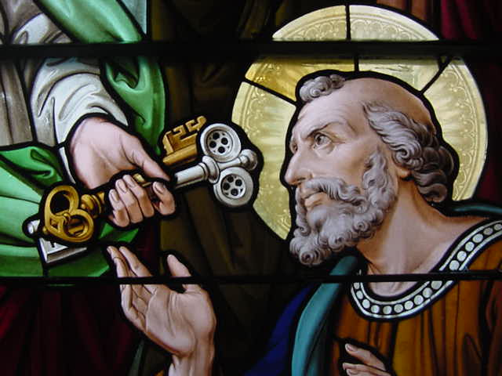
Authoritative Church
¹⁹ I will give you the keys to the kingdom of heaven. Whatever you bind on earth shall be bound in heaven; and whatever you loose on earth shall be loosed in heaven.”
Matthew 16:19
Notes:
Matthew 16:19
¹⁹ I will give you the keys to the kingdom of heaven. Whatever you bind on earth shall be bound in heaven; and whatever you loose on earth shall be loosed in heaven.”
That’s a lot of power! Jesus was talking directly to Peter, a person, a man on earth, not to a generality of “churches” or a mystic body of all Christians. He is giving all authority to one man, Peter.

Slide 50
Authoritative Church
What if I gave you my car keys and said, “Here is my car. I trust you to use it as you would your own. You will decide who may ride in it and you will decide who may not.”?
Notes:
What if I gave you my car keys and said,
“Here is my car. I trust you to use it as you would your own.
You will decide who may ride in it and you will decide who may not.”?
You now have total control over my car, with my blessing and YOU make all the decisions about its use.

Slide 51
Authoritative Church
Jesus Delegates all power to the Apostles
Matthew 28:18-20 ¹⁸ Then Jesus approached and said to them, “All power in heaven and on earth has been given to me. ¹⁹ Go, therefore, and make disciples of all nations, baptizing them in the name of the Father, and of the Son, and of the holy Spirit, ²⁰ teaching them to observe all that I have commanded you. And behold, I am with you always, until the end of the age.”
Notes:
Jesus Delegates all power to the Apostles
Matthew 28:18-20 ¹⁸ Then Jesus approached and said to them, “All power in heaven and on earth has been given to me. ¹⁹ Go, therefore, and make disciples of all nations, baptizing them in the name of the Father, and of the Son, and of the holy Spirit, ²⁰ teaching them to observe all that I have commanded you. And behold, I am with you always, until the end of the age.”
He wasn’t talking about the end of their lives. So if He is with them until the end of the age, He MUST be speaking of their successors.

Slide 52
Authoritative Church
Power to discipline
Matthew 18:17 ¹⁷ If he refuses to listen to them, tell the church. If he refuses to listen even to the church, then treat him as you would a Gentile or a tax collector.
Notes:
Power to discipline
Matthew 18:17
¹⁷ If he refuses to listen to them, tell the church. If he refuses to listen even to the church, then treat him as you would a Gentile or a tax collector.

Slide 53
Authoritative Church
power to legislate
Matthew 18:18 ¹⁸ Amen, I say to you, whatever you bind on earth shall be bound in heaven, and whatever you loose on earth shall be loosed in heaven.
Notes:
power to legislate
Matthew 18:18 ¹⁸ Amen, I say to you, whatever you bind on earth shall be bound in heaven, and whatever you loose on earth shall be loosed in heaven.

Slide 54
Authoritative Church
power to speak with Christ’s voice
Luke 10:16 ¹⁶ Whoever listens to you listens to me. Whoever rejects you rejects me. And whoever rejects me rejects the one who sent me.”
Notes:
power to speak with Christ’s voice
Luke 10:16 ¹⁶ Whoever listens to you listens to me. Whoever rejects you rejects me. And whoever rejects me rejects the one who sent me.”

Slide 55
Authoritative Church
power to forgive sins
John 20:21-23
²¹ [Jesus] said to them again, “Peace be with you. As the Father has sent me, so I send you.” ²² And when he had said this, he breathed on them and said to them, “Receive the holy Spirit. ²³ Whose sins you forgive are forgiven them, and whose sins you retain are retained.”
Notes:
power to forgive sins
John 20:21-23
²¹ [Jesus] said to them again, “Peace be with you. As the Father has sent me, so I send you.” ²² And when he had said this, he breathed on them and said to them, “Receive the holy Spirit. ²³ Whose sins you forgive are forgiven them, and whose sins you retain are retained.”

Slide 56
Authoritative Church
Power to offer sacrifice (Eucharist)
1 Corinthians 11:23-24 ²³ For I received from the Lord what I also handed on to you, that the Lord Jesus, on the night he was handed over, took bread, ²⁴ and, after he had given thanks, broke it and said, “This is my body that is for you. Do this in remembrance of me.”
Notes:
Power to offer sacrifice (Eucharist)
1 Corinthians 11:23-24 ²³ For I received from the Lord what I also handed on to you, that the Lord Jesus, on the night he was handed over, took bread, ²⁴ and, after he had given thanks, broke it and said, “This is my body that is for you. Do this in remembrance of me.”

Slide 57
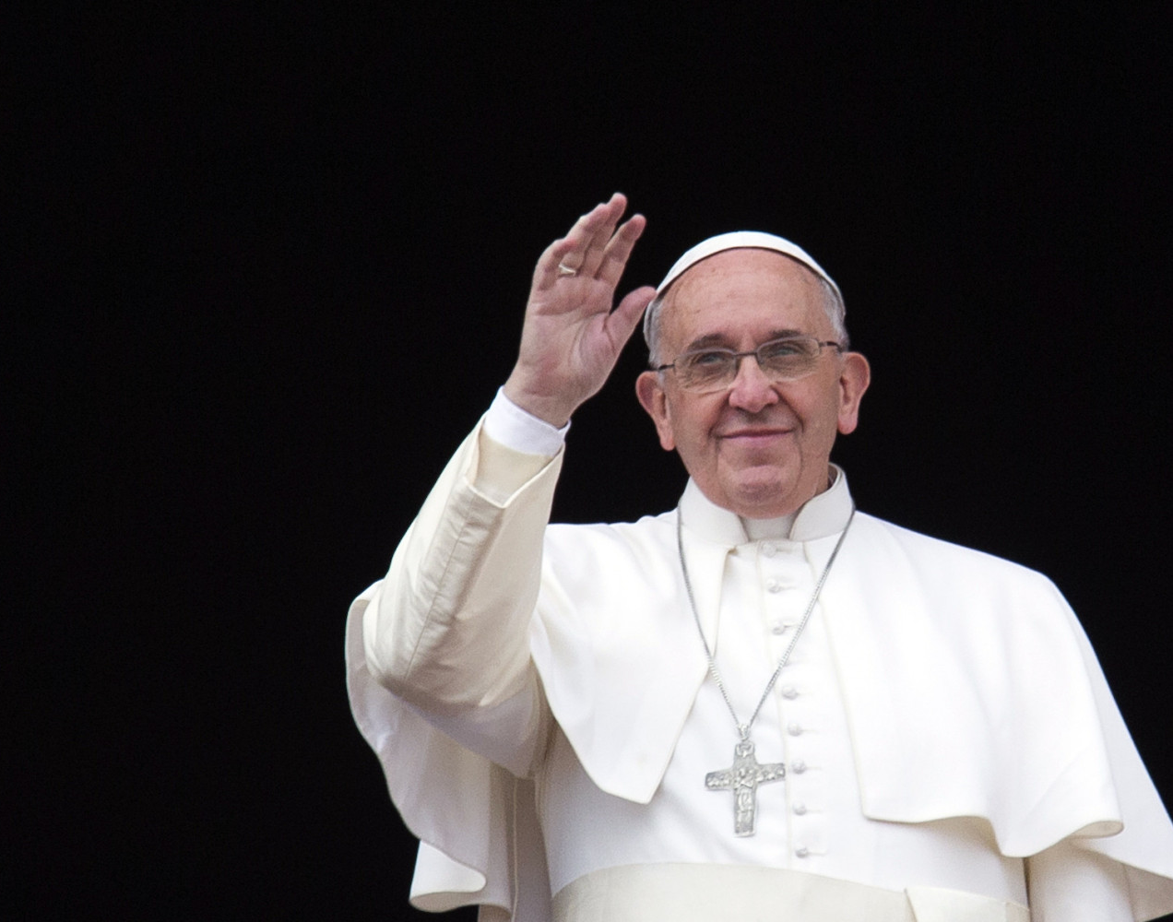
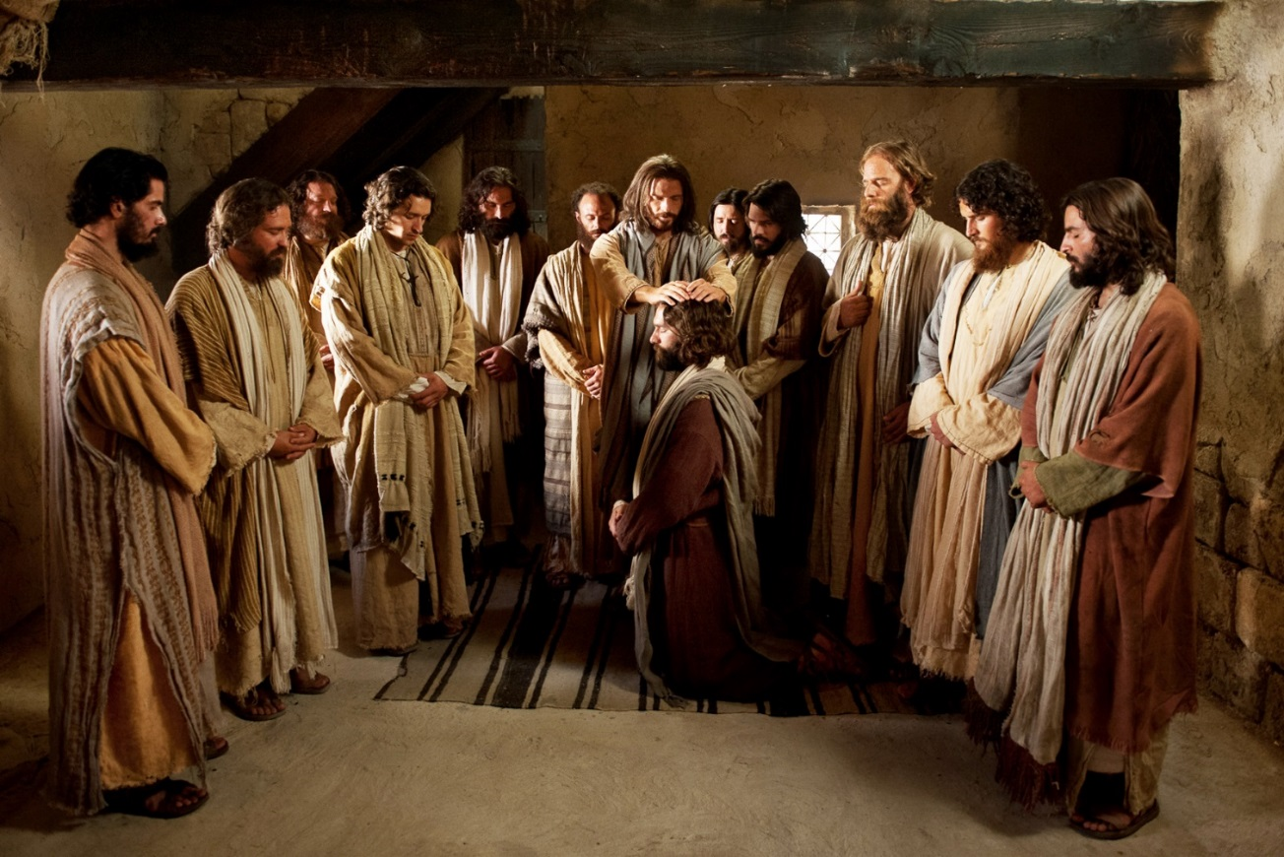
Authoritative Church
All of this power and more was given to the Apostles directly by Christ to hand down to their successors
until the end of the age.
Notes:
All of this power and more was given to the Apostles directly by Christ to hand down to their successors until the end of the age.
This is the source of the Authoritative Church.

Slide 58
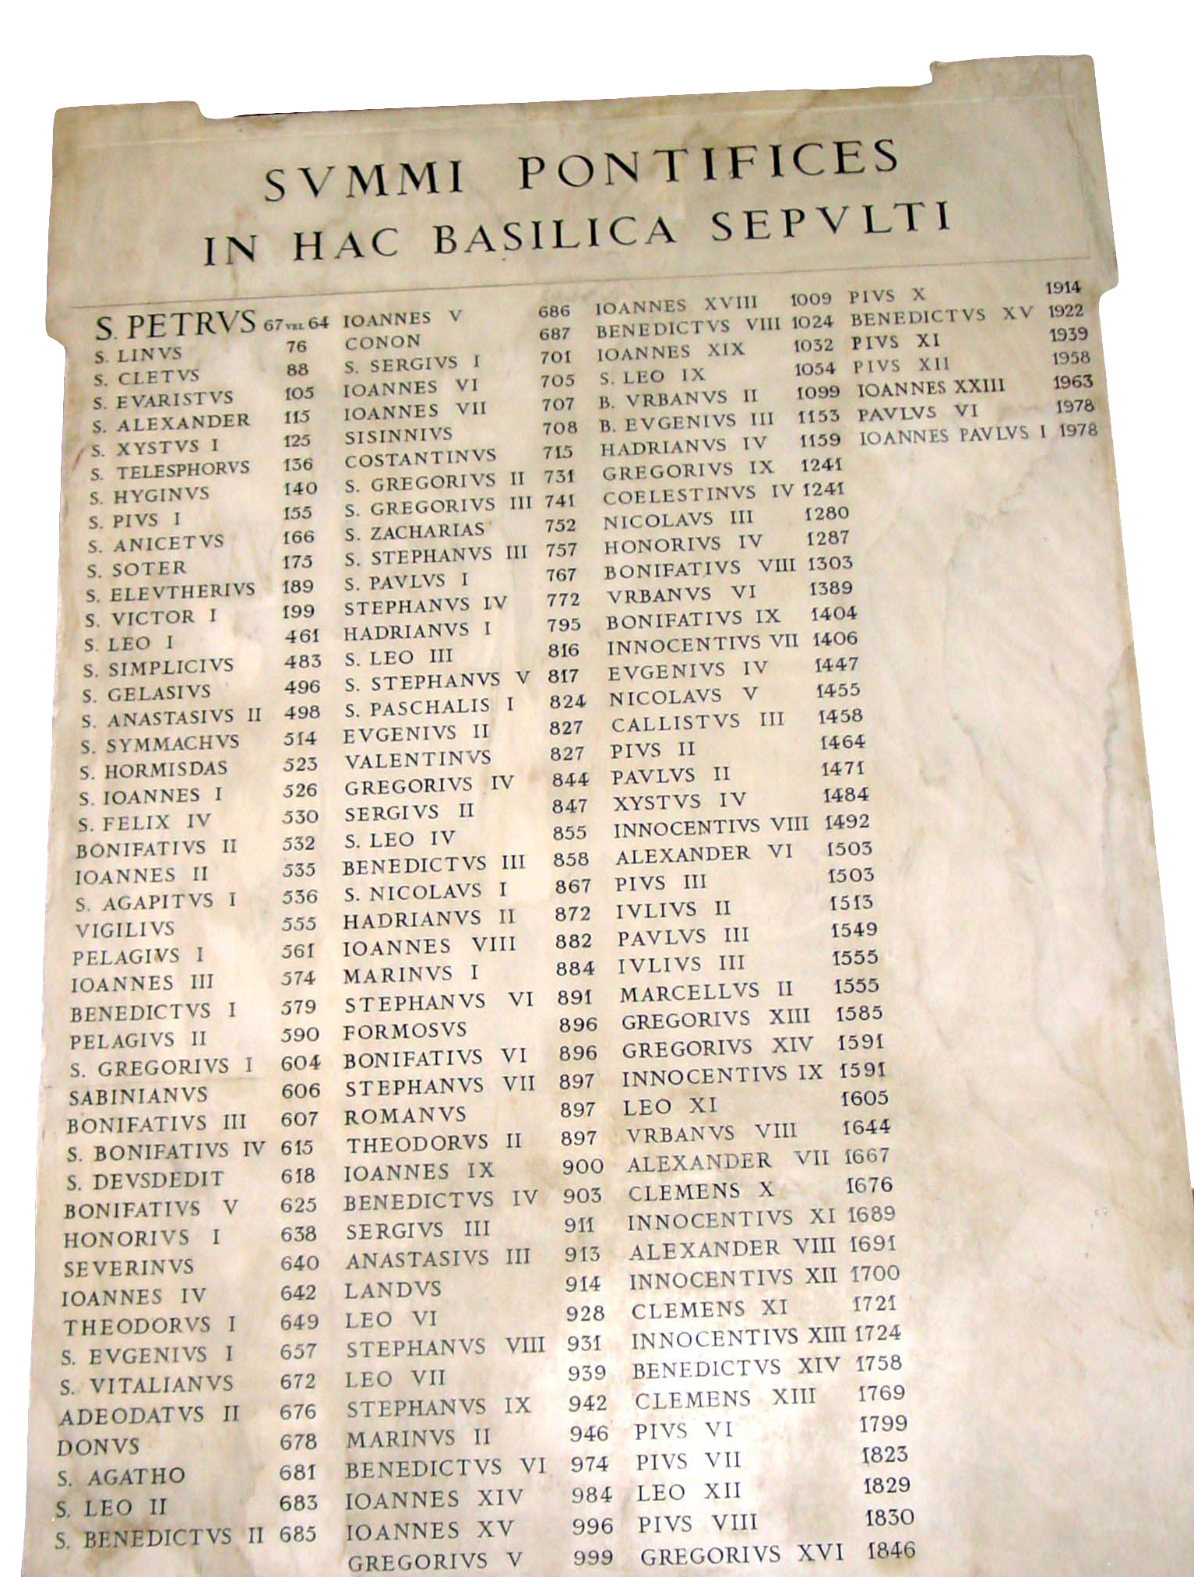
Apostolic Succession
Next session…
Notes:
All of this power and more was given to the Apostles directly by Christ to hand down to their successors until the end of the age.
This is the source of the Authoritative Church.

Slide 59
Apologetics… Defending the Faith
Scripture in Support of Our Catholic Beliefs

